Slide 1
IOT DEMO
MS Band + Azure
Peter Daukintis @peted70
David Gristwood @scroffthebad
Microsoft Ltd

Slide 2
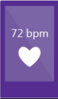
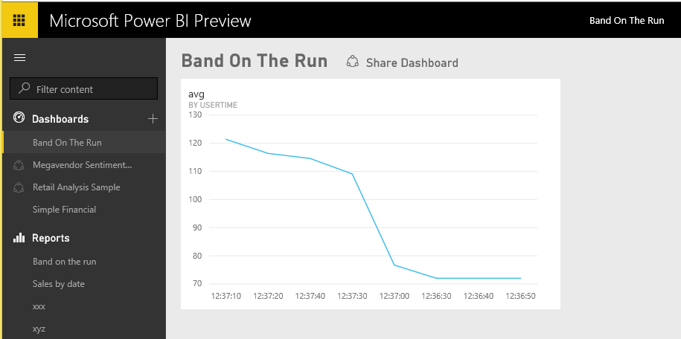
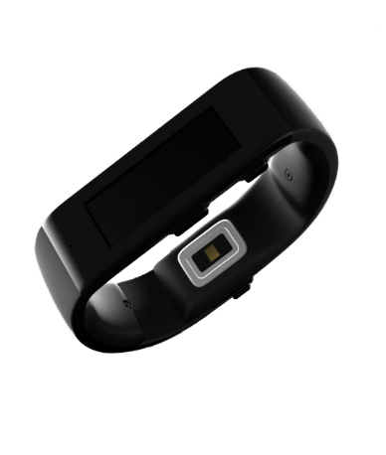

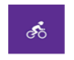
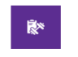

Event hubs
Stream Analytics

Slide 3
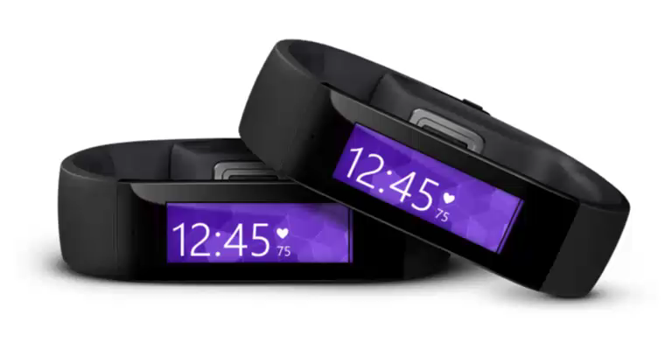
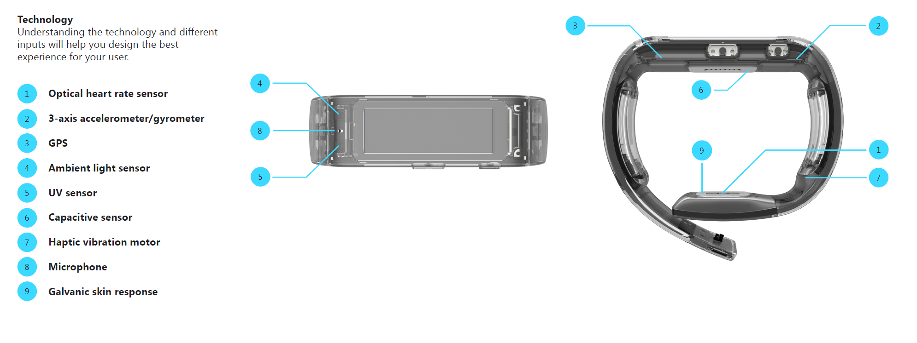
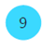
What is the Band?
All day wearable device
Live healthier
Be more productive
Stay connected at a glance
Advanced Technology
10 sensors
Touch display
2 days+ battery life
10
10
Gyroscope

Slide 4
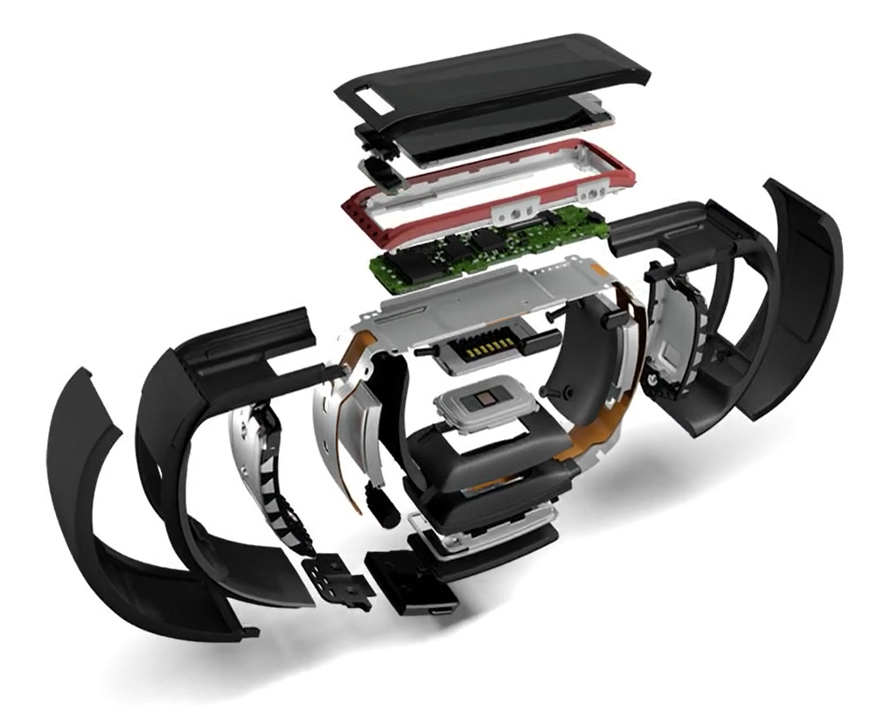
Band SDK
Native SDKs for iOS, Android, Windows and Windows Phone – also a Xamarin SDK
3 ways to interact:
Create interactive tiles
Personalise and customise
Stream data from the sensors
Notes:
(can’t currently run code on the band – external device is required)
• Multi-platform support
• Sensor data subscriptions
• Tile creation and management
• Tile notifications
• Custom layouts
• Haptic notifications
• Band theme personalization
Windows Phone 8.1 and later
Windows 8.1 and later (Store Apps)
iOS 7 and later
Android 4.2 (API 17) and later

Slide 5
Programming Model
Band Client Manager
Band Client
Personalisation Manager
Tile Manager
Sensor Manager
Notification Manager
Heart Rate
UV
Skin Temp
Reading Changed Event
START
READING
Request Consent
Notes:
Currently only the heart rate data requires consent.

Slide 6
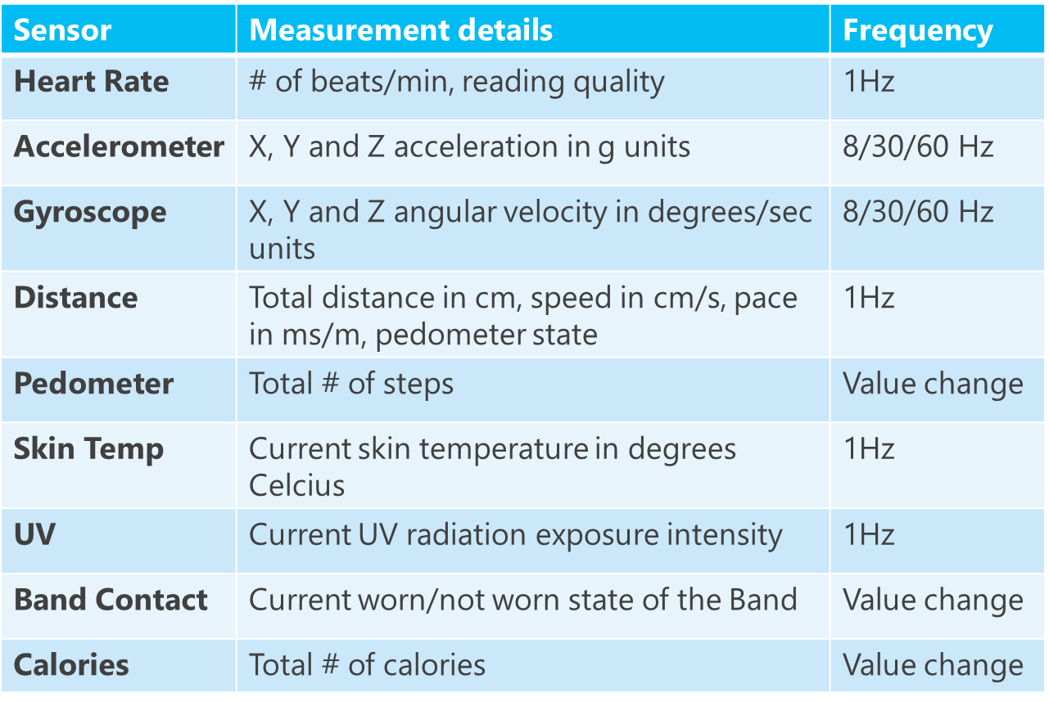
Sensor Data

Slide 7
CODE

Slide 8
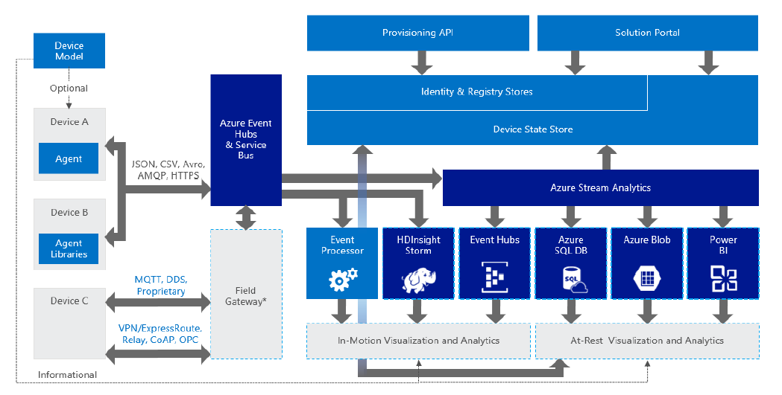
IoT Reference Architecture

Slide 9
Event Hubs Cloud-scale telemetry ingestion from websites, apps, and devices
Log millions of events per second in near real time
Connect devices with authorization & throttling
Time-based event buffering
Managed service with elastic scale
Pluggable adapters for other cloud services
Notes:
Stream millions of events per second into multiple applications
Event Hubs is a highly scalable publish-subscribe ingestor that can intake millions of events per second so that you can process and analyze the massive amounts of data produced by your connected devices and applications. Once collected into Event Hubs you can transform and store data using any real-time analytics provider or with batching/storage adapters.
Enable applications to process events with variable load profiles
Today’s connected world is defined by big data. Big data originates from many sources such as connected cars and thermostats that produce telemetry data every few minutes, application performance counters that generate events every second or mobile apps that capture telemetry for every user’s individual action. In this connected world, you need a managed ingestor service capable of elastic scale in order to accommodate variable load profiles as well as the spikes caused by intermittent connectivity.
Connect millions of devices across platforms
The rapid proliferation of connected devices raises challenges due to the variety of platforms and protocols involved. Connecting these disparate data sources while handling the scale of the aggregate stream is a significant challenge. Event Hubs provide easy provisioning of capacity to ingest events from millions of devices while preserving event order on a per device basis. Support for AMQP and HTTP allow many platforms to work with Event Hubs. Native client libraries also exist for popular platforms.

Slide 10
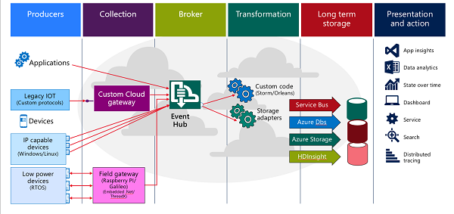
Event Hub Scenario

Slide 11
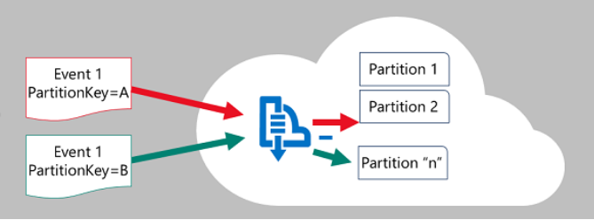
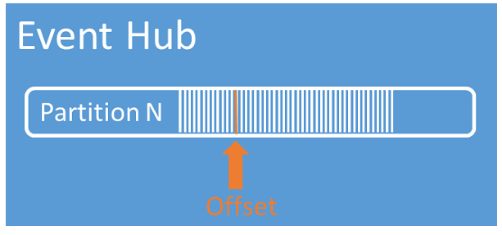
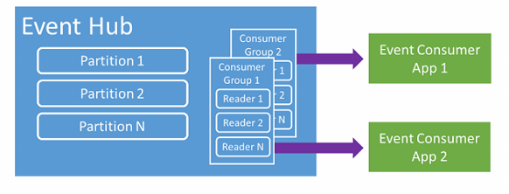

Slide 12
Stream Analytics Real-time stream processing in the cloud
Stream millions of events per second
Perform real-time analytics
Correlate across multiple streams of data
Reliable performance and predictable results
Rapid development with SQL-like language
Notes:
Real-time business insights
Stream Analytics is an event processing engine that helps uncover real-time insights from devices, sensors, infrastructure, applications and data. It will enable various opportunities including Internet of Things (IoT) scenarios such as real-time fleet management or gaining insights from devices like mobile phones or connected cars.
Stream millions of events per second
Stream Analytics provides out-of-the-box integration with Event Hubs to ingest millions of events per second. Together, Event Hubs and Stream Analytics let you process massive amounts of real-time data so you can make business decisions in real-time.
Real-time processing
Stream Analytics will process ingested events in real-time, comparing multiple real-time streams or comparing real-time streams together with historical values and models. This enables the detection of anomalies, transformation of incoming data, or the ability to trigger an alert when a specific error or condition appears in the stream.
Reliability, performance & predictable results
Scale to any volume of data while still achieving high throughput, low-latency, and guaranteed resiliency. Stream Analytics can process data at high throughput with predictable results and no data loss.
Up and running in minutes
Stream Analytics is a highly scalable, real-time event processing solution with no hardware or other up-front costs and no time-consuming installation or set-up. Azure does it all for you. You can be up and running in minutes.
Enables rapid development
Reduce friction and complexity when developing analytic functions for scale-out distributed systems. Developers simply describe their desired transformation with SQL-based syntax and the system will automatically distribute it for scale, performance, and resiliency.

Slide 13
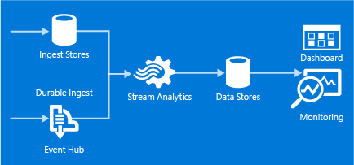
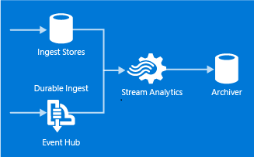
Stream Analytics Scenarios
Telemetry & log analysis via dashboards
Event archival for future processing

Slide 14
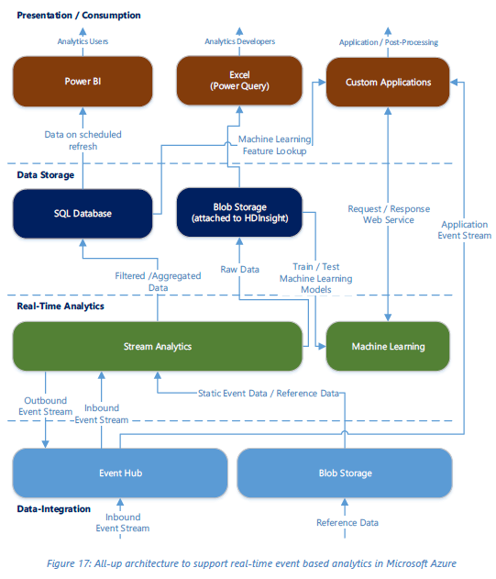
Reference architecture

Slide 15
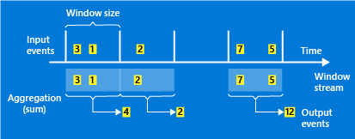
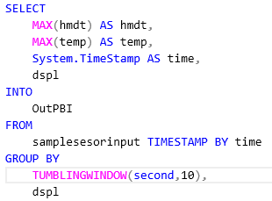
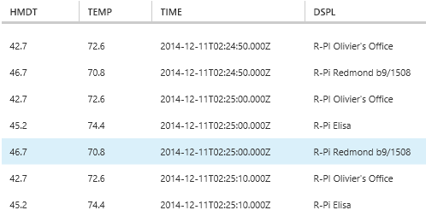
Stream Analytics Windowing
Concept of time is a fundamental necessity to complex event-processing systems
Subsets of events are defined through ”windows” to represent groupings by time.

Slide 16
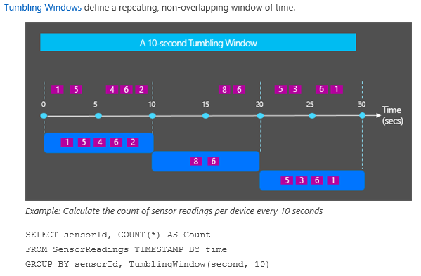
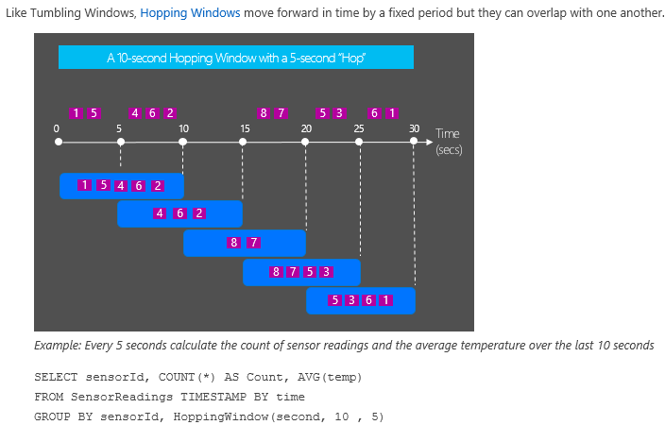
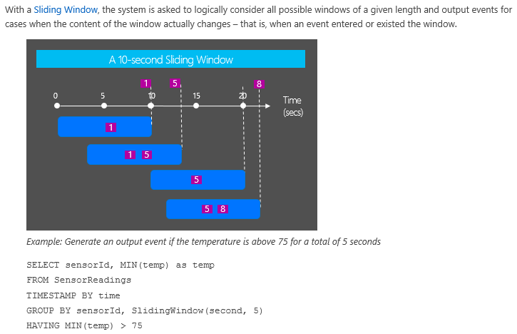

Slide 17
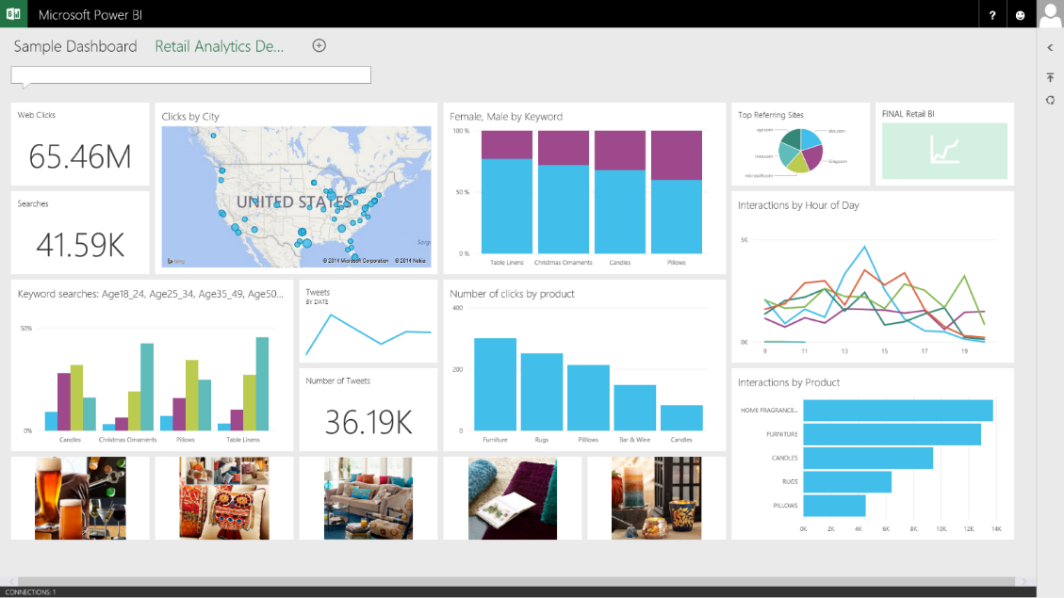
Power BI Dashboard See all your data in a single pane of glass
Dashboards
Monitor live dashboards for the data that matters most
Ask questions of your data through natural language query
Drill through to underlying reports to explore and discover new insight
Pin new visualizations and KPIs to monitor performance
Notes:
Power BI dashboards
With updates to Power BI customers can now see all their data through a single pane of glass. Live Power BI dashboards show visualizations and KPIs from data that reside both on-premises and in the cloud, providing a consolidated view across their business regardless of where their data lives.
Simplifying how you interact with data, natural language query is built into the dashboard allowing users to type questions and receive answers from data in the form of interactive visualizations.
You can then explore their data further by drilling through the dashboard into the underlying reports, discovering new insights that they can pin back to the dashboard to monitor performance going forward.

Slide 18
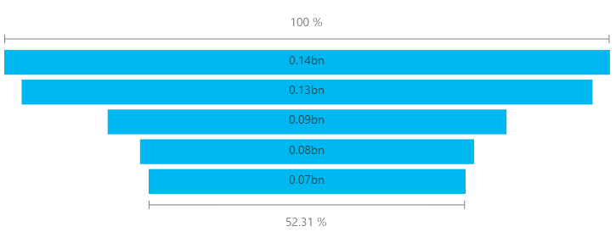
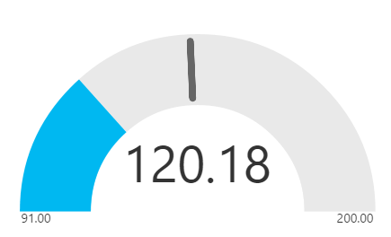
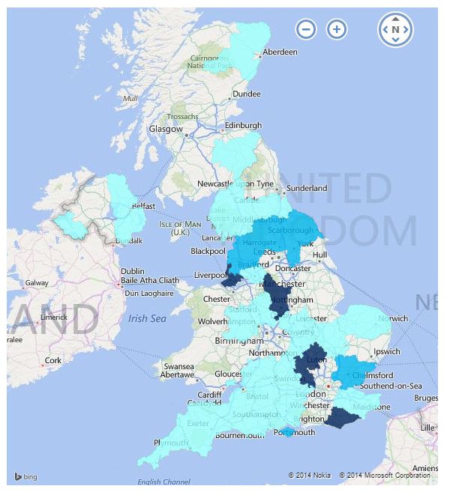
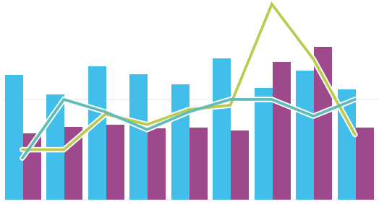
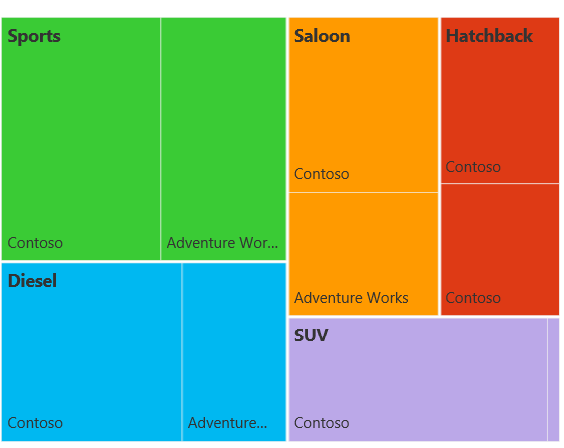
Visualize your data in new ways New Power BI Visualizations
Funnel
Gauge
Fill Map
Combo Chart
Tree Map
Notes:
We continue to enrich the visualizations that are available in the service. Visualizations now include combo charts, fill maps, gauges, tree maps, and funnel charts.

Slide 19
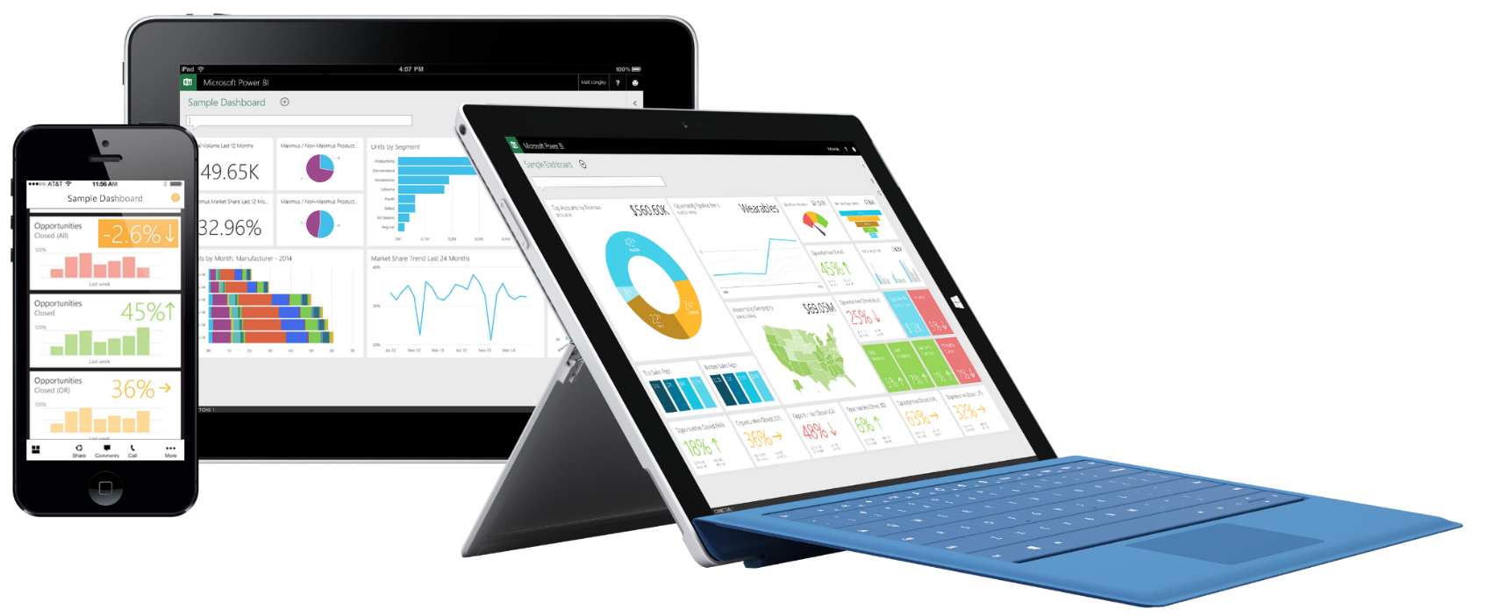
Stay connected from any device
Native apps for iPad, iPhone, and Windows devices
Receive alerts to important changes in your data
Share and collaborate with colleagues and take immediate action
Notes:
Stay connected from any device
We are working on the next wave of mobile apps for Power BI. These apps will allow users to access their Power BI dashboards through immersive mobile apps for iPad, iPhone, Windows, and Android devices – releasing throughout H1 CY2015. On Dec 18th the iPad app will be the first available and found in the Apple store, with the other apps following in the coming months. These apps will also allow users to receive alerts to important changes in their data as well as to share and collaborate with colleagues so that they can take immediate action, from any device.

Slide 20
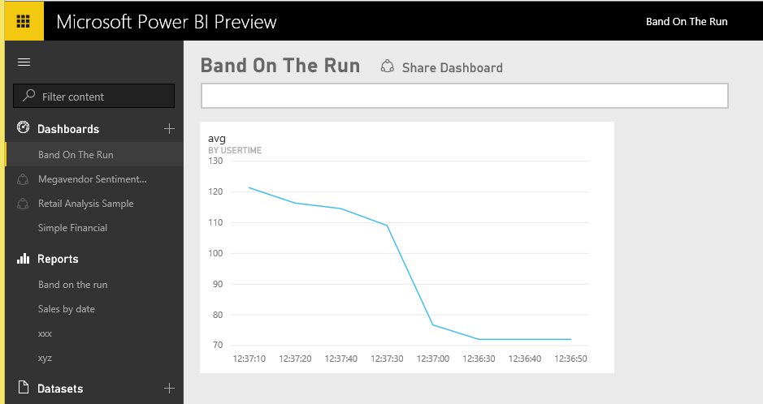

Slide 21
Demo

Slide 22
What now?
http://developer.microsoftband.com/
Download the SDK and documentation
Check out samples
Go develop!
http://www.microsofthealth.com/
http://www.microsoftband.com/
http://lumiaconversations.microsoft.com/
Blogs and news about upcoming features
healthms@microsoft.com
SDK questions and feedback

